Slide 1
Calculations Guide
Paolo Jordano, Incandela Lab, UCSB

Slide 2
ALL CMS HGCAL MODULE SHAPES:
HD Shapes
Full Bottom Top Right Left
LD Shapes
Full Five Right Left Bottom Top

Slide 3
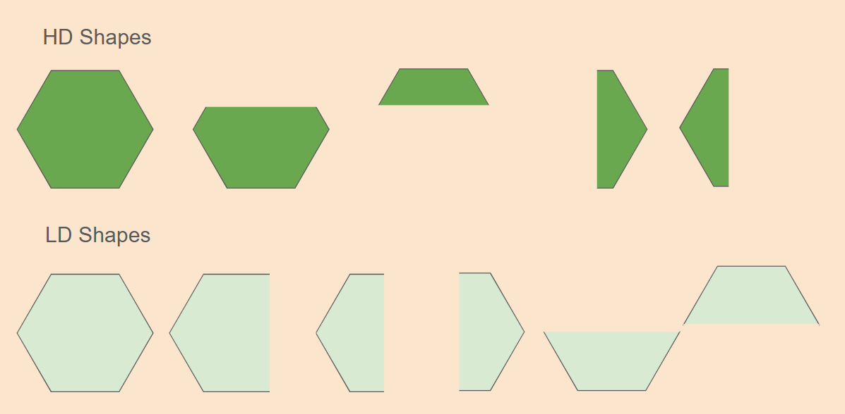
The LD Full Tray, and Compatible Modules
← The Full Assembly Tray
[Located at TTU & CMU]
OffCenter Center
CH1
CH1
Center OffCenter

Slide 4
[Full Assembly Tray] Possible Modules
HD & LD Full
CH1
CH1

Slide 5
Calculation Examples:
Shapes | P1 Pins | P2 Pins | Two Fiducial Points | Four Fiducial Points
LD Full | P1Center & P1OffCenter | P2Center & P2OffCenter | FDCenter = AVG(FD6, FD3) Offsets = Center - FDCenter PinSlope = Center - OffCenter PinAngle = ATAN(PinSlope)*57.3 FDSlope = (FD2y - FD3y)/(FD2x - FD3x) FDAngle = ATAN(FDSlope)*57.3 OffsetAngle = FDAngle - PinAngle | FDCenter = AVG(FD1, FD2, FD4, FD5) Offsets = PinCenter - FDCenter PinSlope = Center - OffCenter PinAngle = ATAN(PinSlope)*57.3 FDSlope = (FD2y - FD3y)/(FD2x - FD3x) FDAngle = ATAN(FDSlope)*57.3 OffsetAngle = FDAngle - PinAngle
This Calculation (or very similar) will apply for the Following Shapes

Slide 6
The Partials Tray, and Compatible Modules
←This is a THE ORIGINAL Partials Tray;
Each Position has 9 Named Pin Locations.
F
A
Center
C
H
E D B G
CH1
OLD CONVENTION
F
A
Center
C
H
CH1
E D B G
These are the modules that can be built on a partials tray

Slide 7
[The Partials Assembly Tray] [pg.1] Possible Modules
HD & LD Full
HD Bottom
CH1
CH1
CH1

Slide 8
[The Partials Assembly Tray] [pg.2] Possible Modules
LD Top
LD Bottom
P1E P1D
P1B P1G
CH1
CH1
CH1
CH1
P2B P2G
P2E P2D

Slide 9
[The Partials Assembly Tray] [pg.3] Possible Modules
LD Five
LD Right
LD Left
P1F
P1A
P1 Center
P1H
P1C
P1H
CH1
CH1
CH1
P2F
P2 Center
P2F
P2A
CH1
CH1
CH1
P2C
P2H

Slide 10
New Partials Tray, and the modules that require it
←This is an HD Partials Tray;
Each Position has 14 Named Pin Locations.
CH1
CH1

Slide 11
[New Partials Tray]
HD Top
HD Right
HD Left
CH1
CH1
CH1
CH1
CH1
CH1

Slide 12
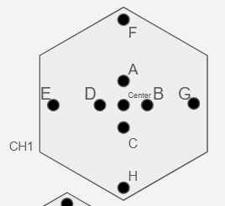
New Partials Assembly Tray: New Pin Names
P
K
F
A
C
H
I
N
Center
O J E D B G L M
CH1
P
K
F
A
C
H
I
N
Original Names
CH1
O J E D B G L M
Center
Symbolic Pins (Not Real)
Old Pins
New Pins

Slide 13
Original Names
P
K
F
A
C
H
I
N
p1A_xy: [142.343, 308.185]
p1B_xy: [152.339, 298.188]
p1C_xy: [142.328, 288.185]
p1D_xy: [132.335, 298.187]
p1E_xy:
p1F_xy:
p1G_xy:
p1H_xy:
p1I_xy:
p1J_xy:
p1K_xy:
p1L_xy:
p1M_xy: [217.334, 298.161]
p1N_xy: [142.336, 223.186]
p1O_xy: [67.337, 298.209]
p1P_xy: [142.339, 373.177]
p1_center_pin_xy: [142.333, 298.179]
p2A_xy: [91.526, 117.722]
p2B_xy: [101.518, 107.713]
p2C_xy: [91.535, 97.709]
p2D_xy: [81.535, 107.712]
p2E_xy:
p2F_xy:
p2G_xy:
p2H_xy:
p2I_xy:
p2J_xy:
p2K_xy:
p2L_xy:
p2M_xy: [166.532, 107.694]
p2N_xy: [91.407, 32.735]
p2O_xy: [16.542, 107.730]
p2P_xy: [91.542, 182.702]
p2_center_pin_xy: [91.532, 107.714]
Center
O J E D B G L M
CH1
P
K
F
A
C
H
I
N
p1A_xy: [142.343, 308.185]
p1B_xy: [152.339, 298.188]
p1C_xy: [142.328, 288.185]
p1D_xy: [132.335, 298.187]
p1E_xy: [67.337, 298.209]
p1F_xy: [142.339, 373.177]
p1G_xy: [217.334, 298.161]
p1H_xy: [142.336, 223.186]
p1_center_pin_xy: [142.333, 298.179]
p2A_xy: [91.526, 117.722]
p2B_xy: [101.518, 107.713]
p2C_xy: [91.535, 97.709]
p2D_xy: [81.535, 107.712]
p2E_xy: [16.542, 107.730]
p2F_xy: [91.542, 182.702]
p2G_xy: [166.532, 107.694]
p2H_xy: [91.407, 32.735]
p2_center_pin_xy: [91.532, 107.714]
CH1
O J E D B G L M
Center

Slide 14
Shapes and Fiducials: New Partials Assembly Tray
Parallel to Pin
CW 90 to Pin
Shapes | Upwards | Downwards | Left | Right
LD Right | FD3→FD1 | FD1→FD3 | FD2→FD4 | FD4→FD2
LD Left | FD3 → FD1 | FD1 → FD3 | FD4→FD2 | FD2→FD4
LD Top | FD4→FD2 | FD2→FD4 | FD3→FD1 | FD1→FD3
LD Bottom | FD2→FD4 | FD4→FD2 | FD3→FD1 | FD1→FD3
LD Five | FD3→FD1 | FD1→FD3 | FD4→FD2 | FD2→FD4
LD Full | FD4→FD2 | FD2→FD4 | FD3→FD6 | FD6→FD3
HD Full | FD4→FD1 | FD1→FD4 | FD2→FD1 | FD1→FD2
HD Left | FD3→FD1 | FD1→FD3 | FD4→FD2 | FD2→FD4
HD Right | FD3→FD1 | FD1→FD3 | FD4→FD2 | FD2→FD4
HD Top | FD4→FD2 | FD2→FD4 | FD3→FD1 | FD1→FD3
HD Bottom | FD2→FD4 | FD4→FD2 | FD1→FD3 | FD3→FD1

Slide 15
Shapes and Pins: New Partials Assembly Tray
Shapes | P1 Center | P1 Off-Center | P2 Center | P2 Off-Center
LD Right | P1A | P1K | P2C | P2I
LD Left | P1C | P1I | P2A | P2K
LD Top | P1D | P1O | P2B | P2M
LD Bottom | P1B | P1M | P2D | P2O
LD Five | P1 Center | P1I | P2 Center | P2K
LD Full | P1 Center | P1O | P2 Center | P2M
HD Full | P1 Center | P1O | P2 Center | P2M
HD Left | P1F | P1P | P2H | P2N
HD Right | P1H | P1N | P2F | P2P
HD Top | P1E | P1O | P2G | P2M
HD Bottom | P1 Center | P1M | P2 Center | P2O

Slide 16


Pin Angle Calculation Examples:
Left Pin Calculation [Shapes + Position] | Right Pin Calculation [Shapes + Position] | Up Pin Calculation [Shapes + Position] | Down Pin Calculation [Shapes + Position]
HD Full P1 LD Full P1 HD Bottom P2 LD Top P1 LD Bottom P2 HD Top P1 | HD Full P2 LD Full P2 HD Bottom P1 LD Top P2 LD Bottom P1 HD Top P2 | LD Five P2 LD Right P1 LD Left P2 HD Right P1 HD Left P2 | LD Five P1 LD Right P2 LD Left P1 HD Right P2 HD Left P1
Left & Right Pin Calculations: | Top & Down Pin Calculations:
Following these rules: the angle offset will return as a small negative angle for a clockwise offset, and a small positive angle for a counterclockwise offset

Slide 17
Pin Coverage, with Example: LD Top
Each partial shape utilizes 2 of the 9 pin locations:
Here you can see pair of LD Tops occupying the tray. The used pins can be seen in Pink.
In This case; P1E & P1D are needed for the P1 Module and P2B & P2G are used for the P2 Module.
Using the line between tray fiducials, and the Line between active pins an angle is taken, This angle is called the Pin Angle, and is used in the calculation of the Offset Angle.
P1E P1D
CH1
CH1
P2B P2G

Slide 18
Pin Coverage, with Example: LD Five
LD Five
In the case of the LD Five, LD Left, and LD Right, the pins are approximately parallel to the the line between tray fiducials
In this case, the the line between tray fiducials becomes the relative axis on which the Pin angle is measured, In this case the Pin angle should be around 0 degrees, rather than around 90 degrees.
P1 Center
P1H
CH1
P2F
P2 Center
CH1

Slide 19
Offsets Calculation
LD Full - CMU - Two Points
CH1
HD Full - UCSB - Four Points
CH1

